Slide 1
COVID-19 COMPARISON BETWEEN U.S.A. AND SOUTH KOREA
Saul Arguelles, Raul Mancilla & Maria Patricia Santos
CIS 3200-03

Slide 2


INTRODUCTION
COVID-19 has impacted everyone’s lives this past year, so it is rather appropriate to have our topic that relates to such. In this presentation, we will show the comparison of COVID-19 data between South Korea and United States.

Slide 3
Table of Contents
Data Analyzation using Azure ML
Data comparison on total deaths/ total cases between the US / South Korea
Model Evaluation
Graph Comparison on ElasticSearch
Data Comparison of confirmed, recovered and death cases
Data comparison in GeoMaps

Slide 4
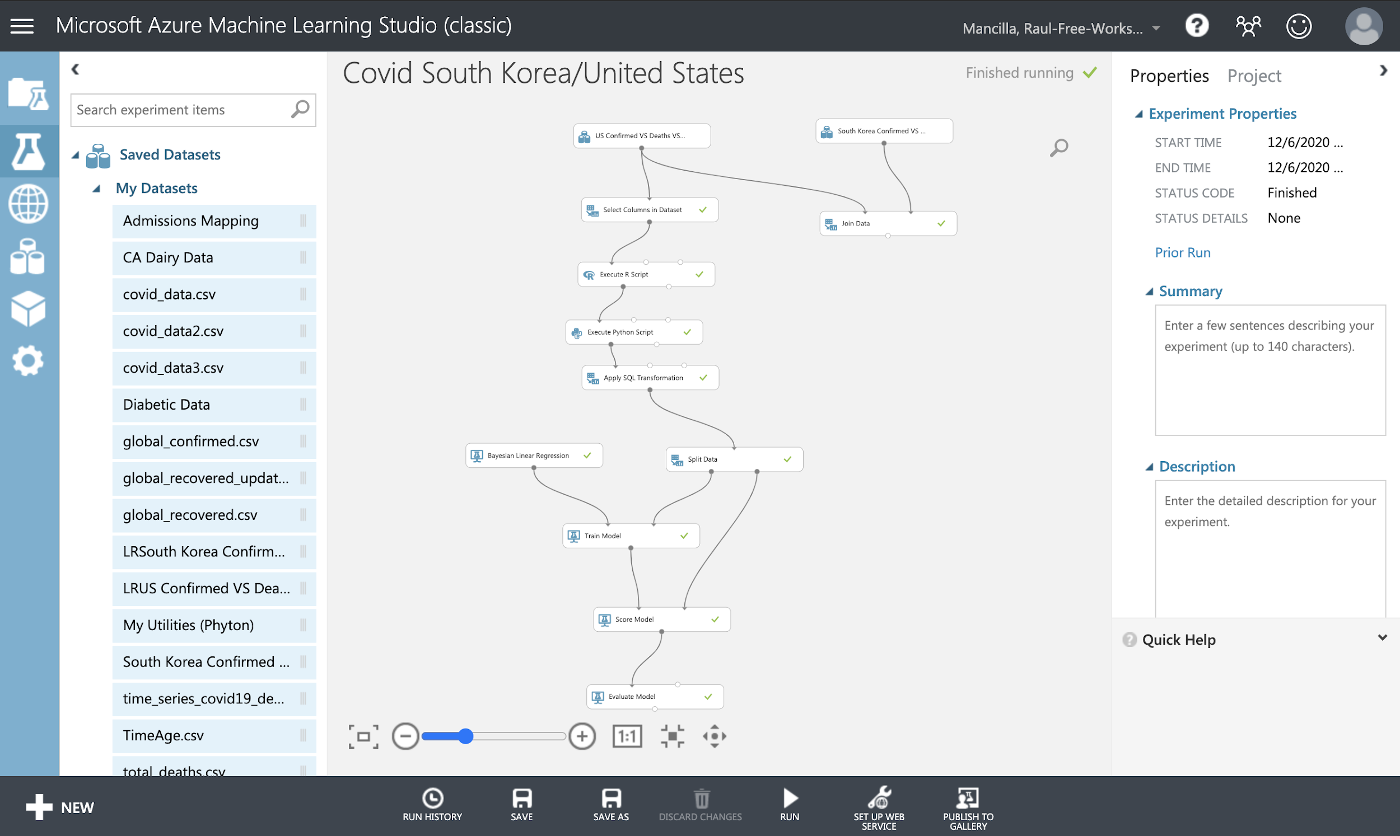
Azure ML
Layout of Azure ML module.
We used 2 different datasets that showed Covid information from South Korea and US.
We used the select column to pick the right columns we needed and executed Python.
We joined two data sets and combined the column to visualize the columns together.
Also we evaluated the models and was able to get the statistics.

Slide 5
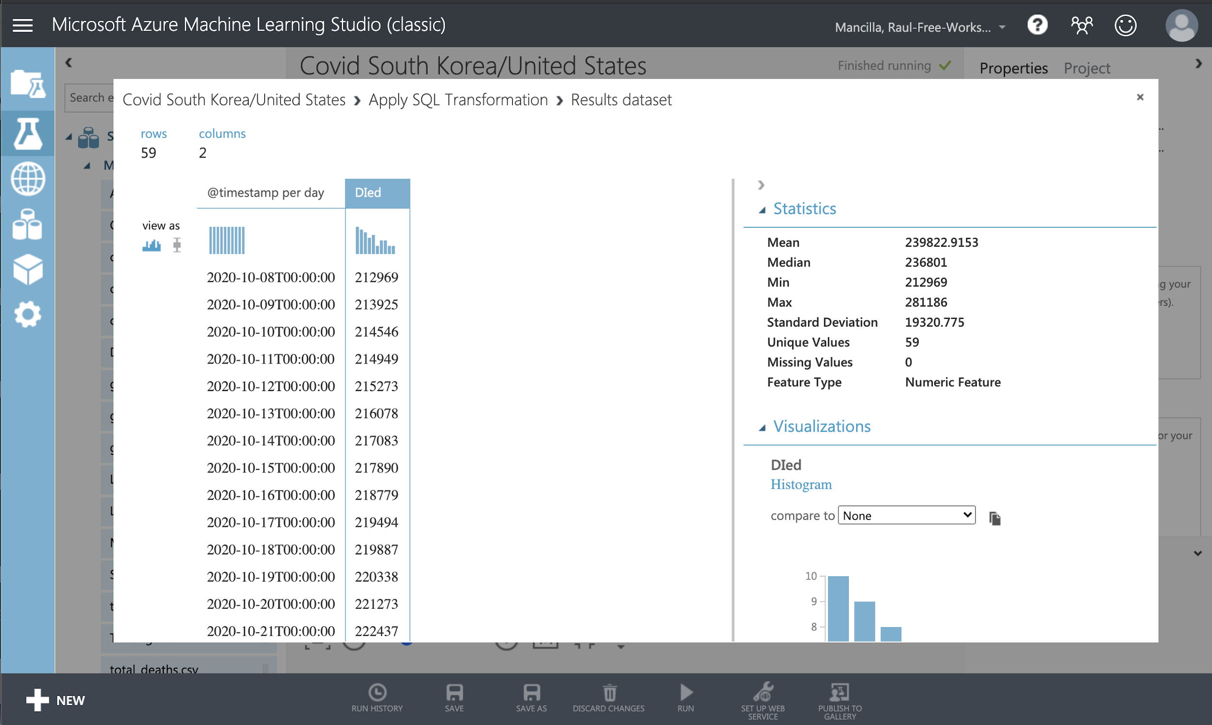
Azure ML
First dataset we used was information about Covid in the US.
We needed to just focus on deaths in the US
Selected the right column and eliminated the ones I didn't need.
Use R script and Python to run the model and show how many deaths are in the US
When visualized we were able to see the data on deaths.

Slide 6
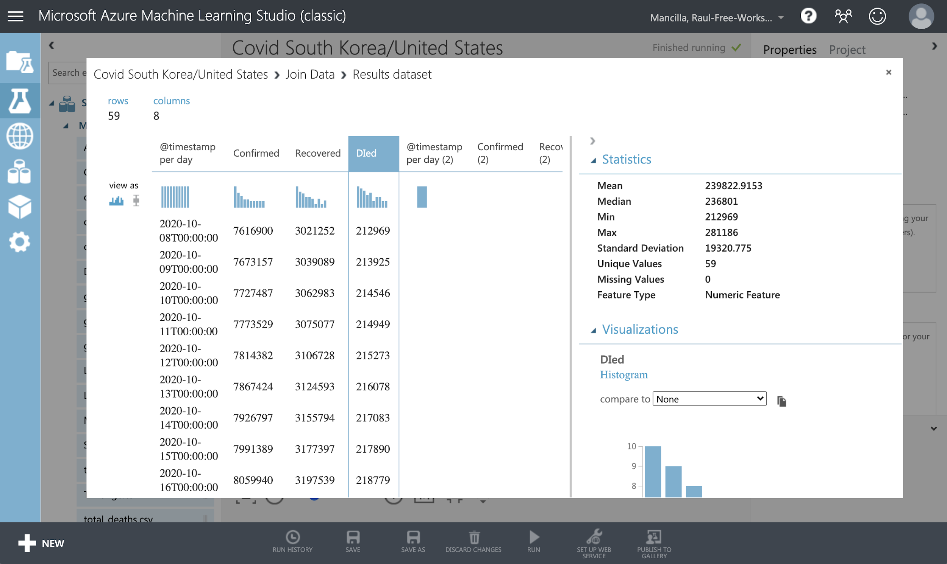
Azure ML
Used the dataset of Covid information from South Korea and US.
We wanted a way to be able to show only the deaths from Covid in South Korea and US.
We used the join function the be able to combine these two datasets.
Selected the right columns and added them together to show the total amount of deaths of the US and South Korea.

Slide 7
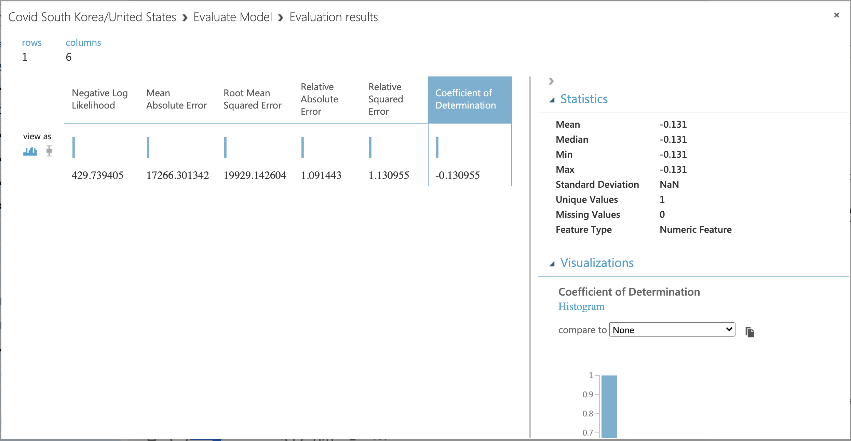
Azure ML
We used both datasets of Covid information to evaluate and score it.
We wanted to predict the number of deaths on a given day based on the dataset.
Used the Relative Squared Error value to indicate how well the model explains variance in the predicted label value.
With a low value of 1.09 it indicates a better predictive result.

Slide 8
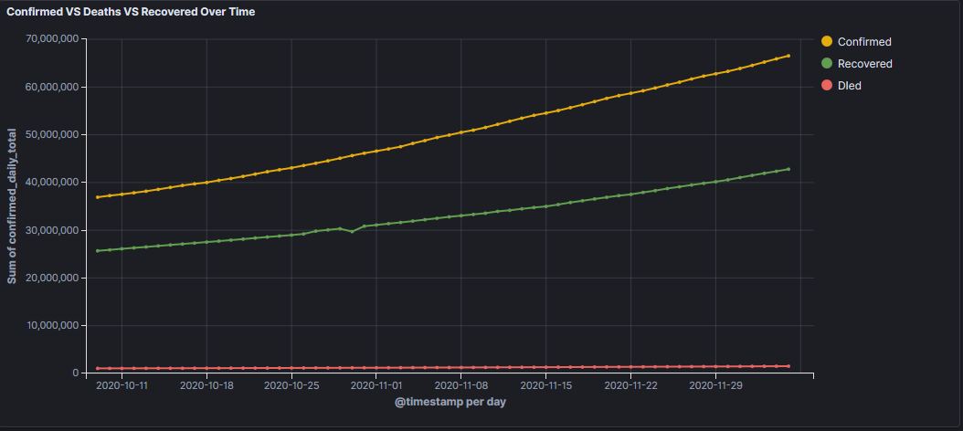
ElasticSearch
This is a graph relating to the total cases according to confirmed, recovered, and dead cases according to the data set we used.
Notes:
53 or 52 percent recovery rate and 2.2 or 2.3 death percentage The U.S total has 15 million cases and 300.000 deaths

Slide 9
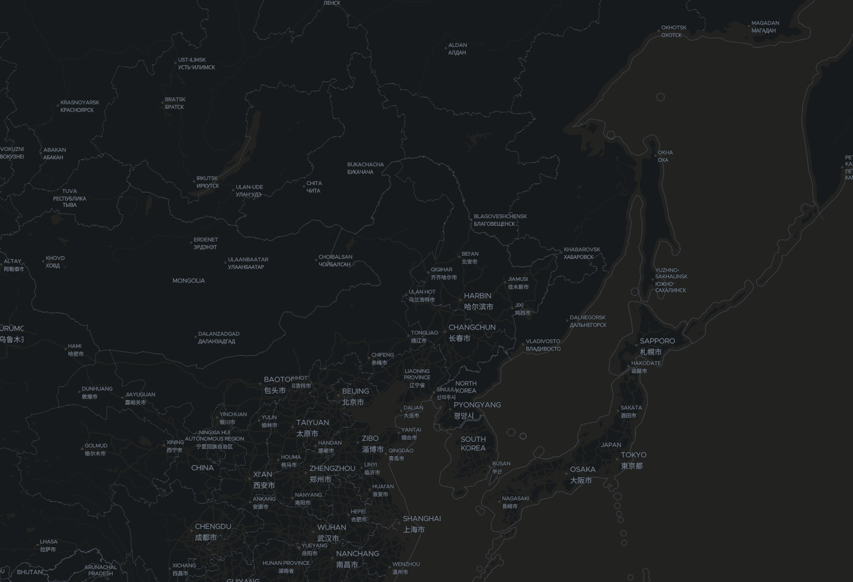
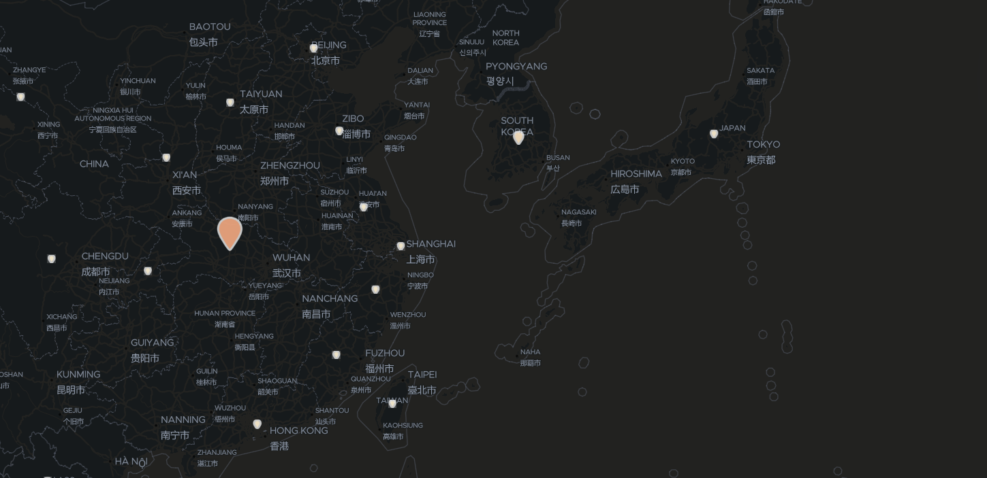
ElasticSearch
About 30,000 confirmed cases of Covid was announced in the beginning of march.
For about two million cases in korea now. Ninety Five percent of cases are clear of covid and the rest are either investigation or in quarantine.

Slide 10
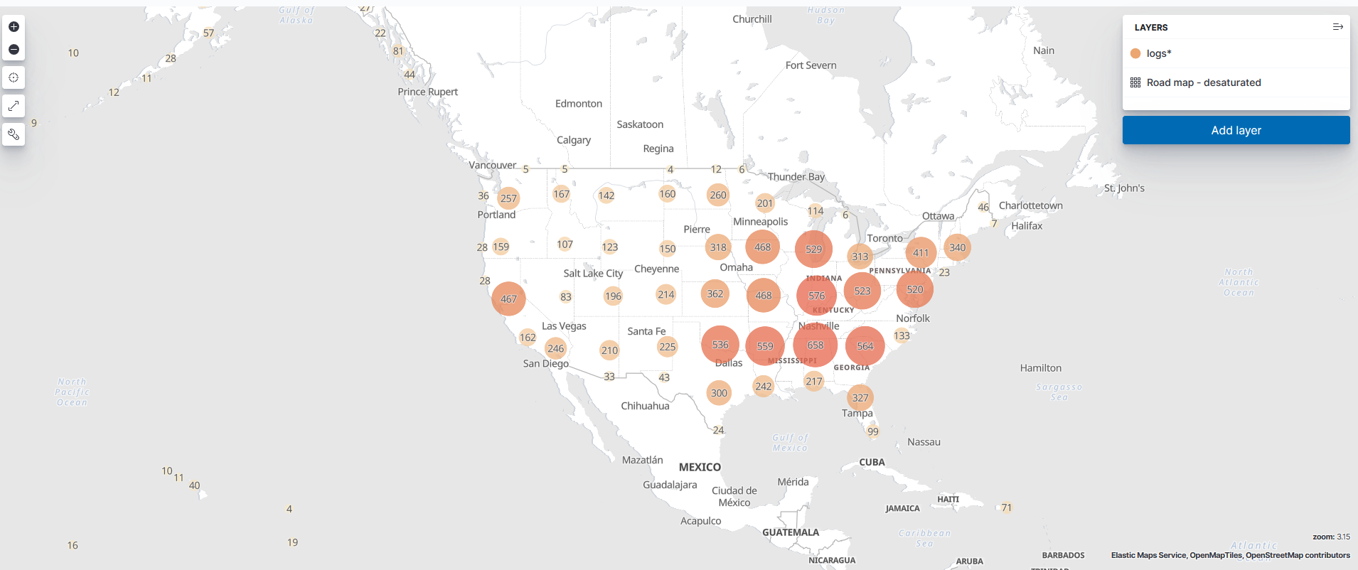
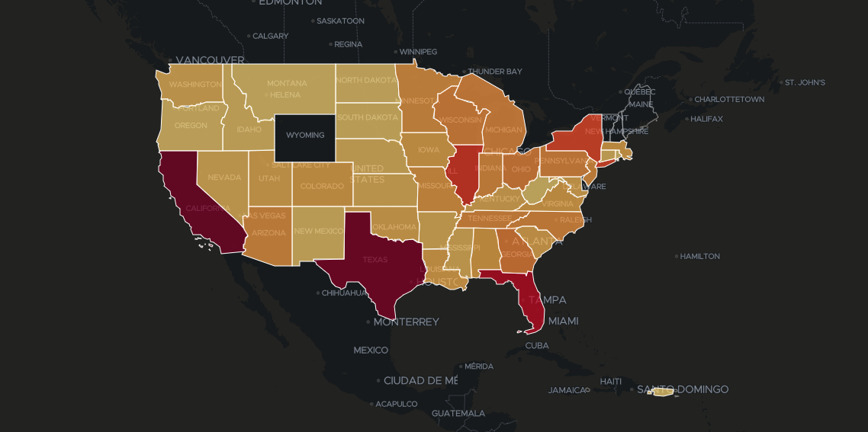
ElasticSearch
About 12,000 cases in the start of the year for America. This number skyrockets within these past three months having millions of confirmed cases just for certain states. The top three states with cases include
California 1.35 million, Texas 1.3 and Florida reaching over a million as well.
Notes:
25 times more than south korea in the top three states.

Slide 11
Insight/ Conclusion
COVID-19 comparison in South Korea / US
South Korea
Start of the data, South Korea had a surge of cases.
End of the data, South Korea has flatten the curve.
United States
Start of the data, United States had minimal cases
End of the data, United States cases continue to rise.
What does this data shows and reflect on what can be done by both countries.
Learnings/ Evaluation of using both programs for comparisons and analysis of data.

Slide 12
References
The Community COVID-19 Dashboard Project. (n.d.). Retrieved December 07, 2020, from https://community.logz.io/covid-19/
Coronavirus Pandemic Data Explorer. (n.d.). Retrieved December 07, 2020, from https://ourworldindata.org/coronavirus-data-explorer?tab=table

